Slide 1

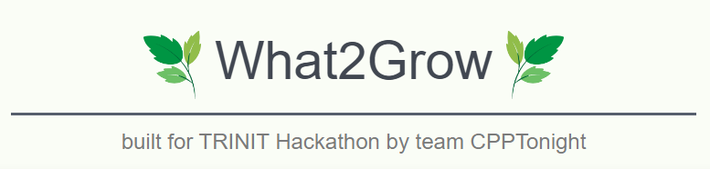

Slide 2



Meet Team CPP Tonight
Sahil Amritkar
Yukta Bhatti
sahil.amritkar@gmail.com
github.com/Sahil-Amritkar
linkedin.com/in/sahil-amritkar-7702981b8
yuktabhatti@gmail.com
github.com/Yukta-1
linkedin.com/in/yukta-bhatti

Slide 3





Table of Contents
Problem Statement
Proposed System
Implementation
Conclusion
The problem and its importance
Overview of the system
Building the system and the results
Our findings and future work

Slide 4

Problem Statement

Slide 5


ML03
Crop Prediction

Slide 6
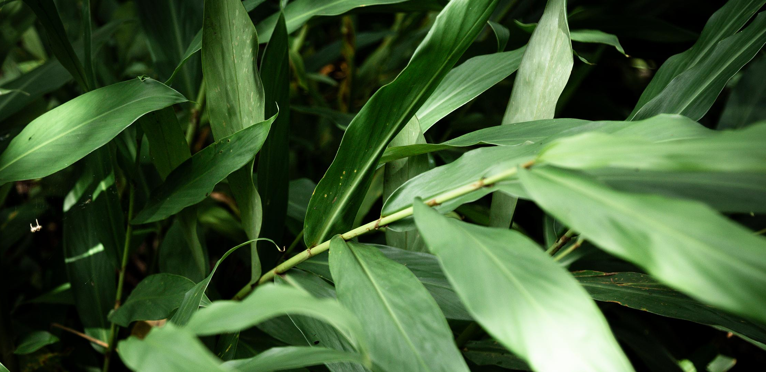
Problem
Predicting the optimal crop that could be grown in a particular location based on
The soil composition
Rainfall
Temperature
Return on investment
is essential for any farmer of the modern world.

Slide 7
Importance
A prediction model could
Save farmers from spending extra money on fertilizers.
Avoid the dangerous practice of growing the same crops on the same patch of land repeatedly, which depletes the solid from its natural resources.

Slide 8

The Brief
1
2
predict what crop would be best for the farmer to
grow based on the geolocation, season, and price.
Build a user-friendly interface for the public to interact with your ML model.
Suggest a variety of crops that could be cultivated for the geo-locations provided in the dataset and rank them according to the sales price.
3
4
factoring in the various types of soil found in various parts of India and its general nutritional composition.

Slide 9
Proposed Solution

Slide 10
INPUTS
MODELS
Merging Algorithm
Optimally combines results from all three models to get the most accurate result
Main
Soil Image
State
District
Season
From Soil Type
Identifies soil types from the uploaded image, and hence best crops to grow in it.
Prevent Soil Depletion Algo
Takes into account NPK usage of previous crop and recommends crops based on that.
Optional
Nitrogen %
Phosphorus %
Potassium %
pH of soil
From Location and Season
Identifies crops that can be grown given the state, district and season
From Conditions
Identifies crops that can be grown from given N,P,K,pH, Temp, Rain and Humidity.
Profit Ranking Algorithm
Ranks the crops based on profit per ha of land
Calculated
Temperature
Humidity
Rainfall

Slide 11
Implementation

Slide 12



Tech Stack
Frontend
Backend
ML
HTML
CSS
Javascript
Python
Flask
Jupyter Notebook
TensorFlow
scikit-learn
Pandas

Slide 13

Modules in Detail

Slide 14
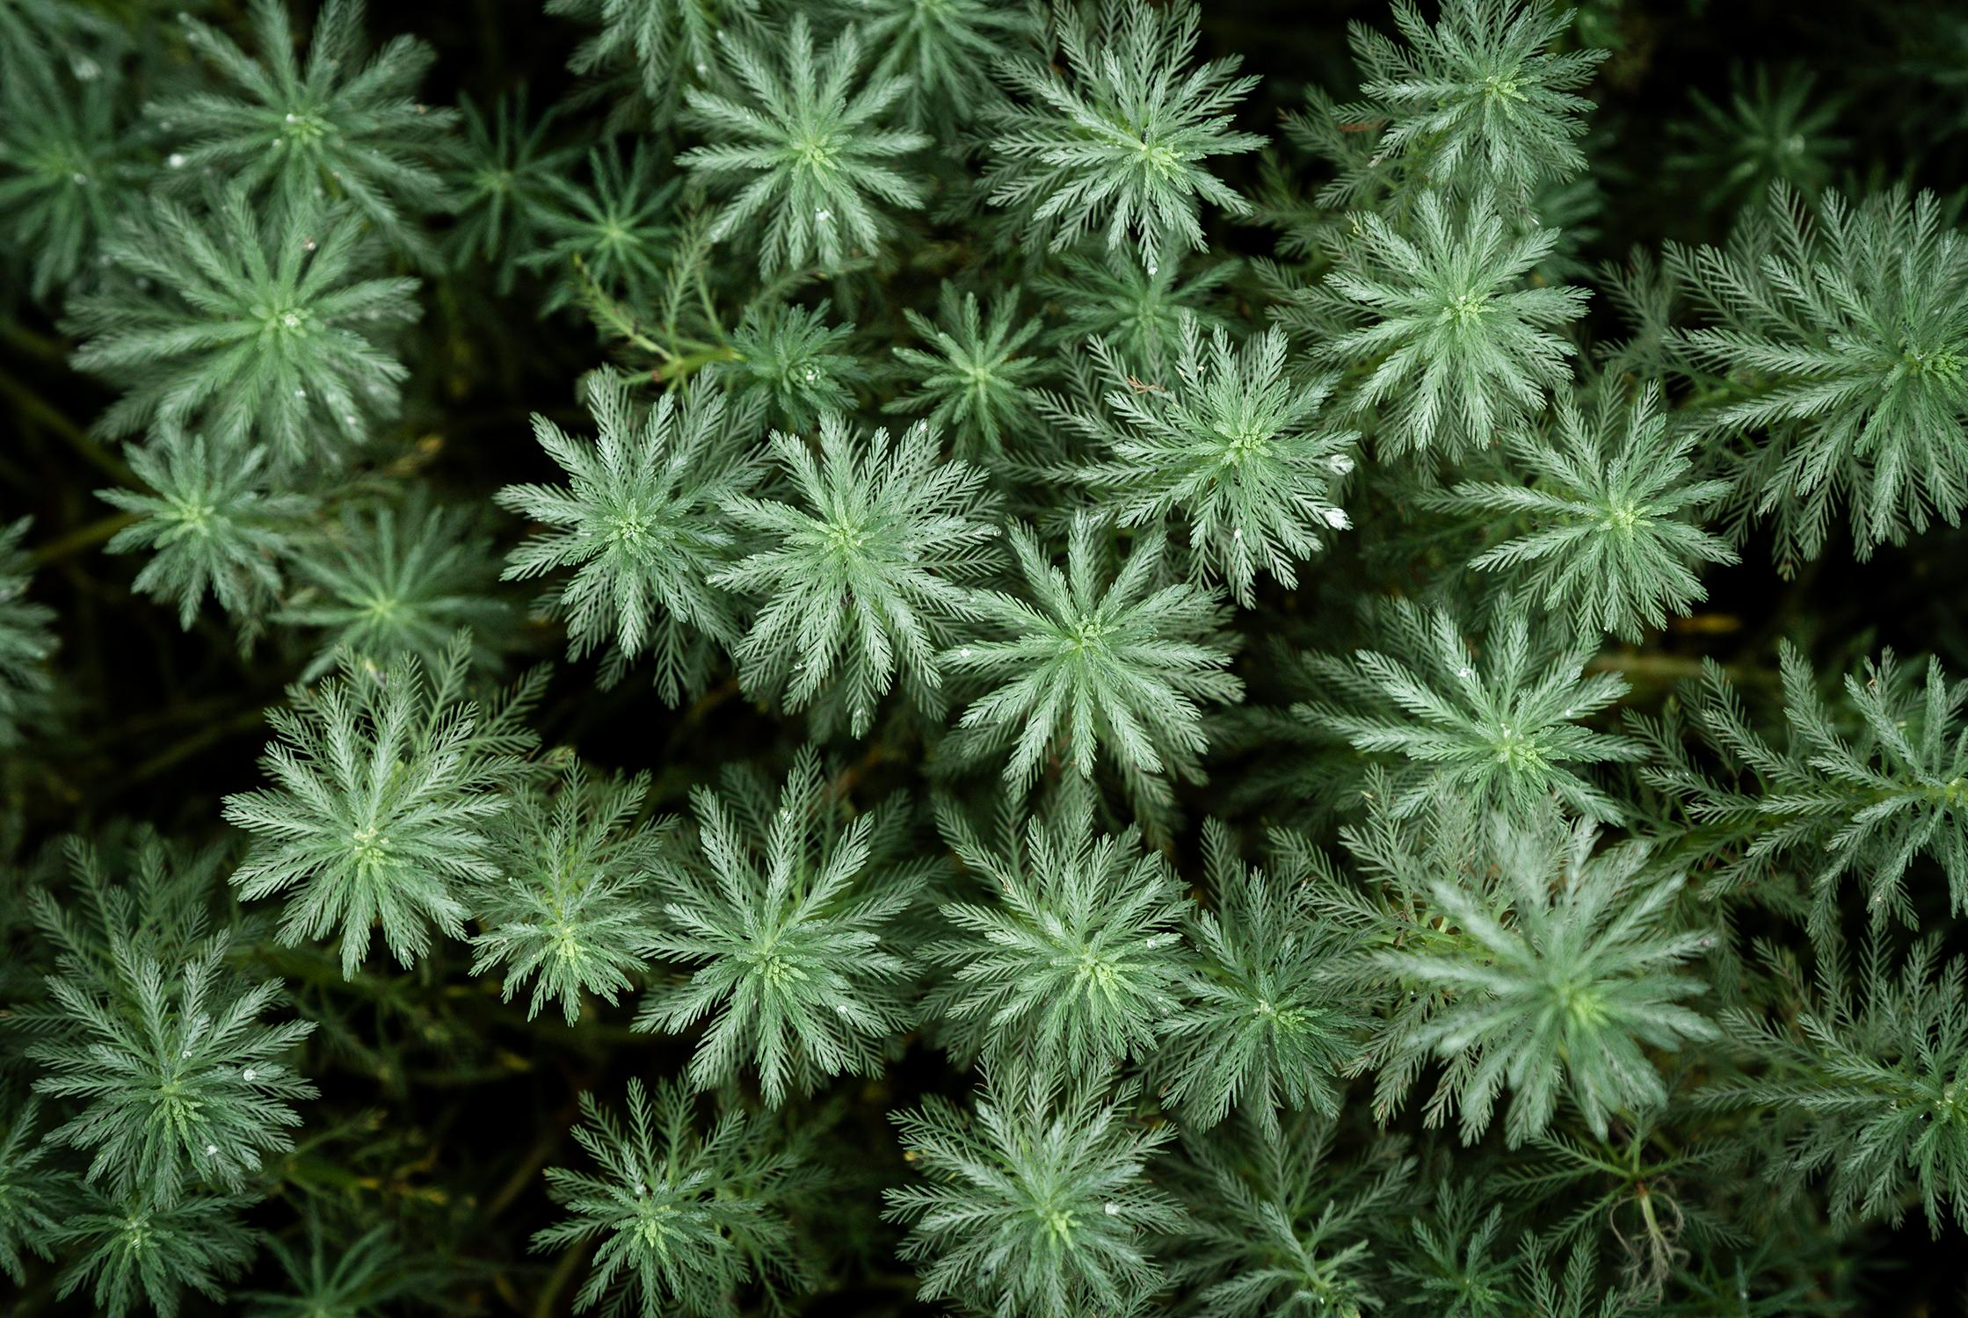
Main Inputs
The following are the required inputs:
State
District
The following are optional inputs:
Season
Previous Crop
Main
Soil Image
State
District
Season

Slide 15
Calculated Inputs
The following variables values are found from datasets for the state and district:
Temperature
Humidity
Rainfall
Calculated
Temperature
Humidity
Rainfall

Slide 16
Soil Type Model
It is a CNN model that achieves an accuracy of 92%.
The soil images dataset is created using a UiPath Script for web scraping.
Based on the soil type recognized, a list of crop recommendations is created.
From Soil Type
Identifies soil types from the uploaded image, and hence best crops to grow in it.

Slide 17
Optional Inputs
If the NPK and pH values are known, you can input them.
If not, based on the soil type predicted by the CNN model, general composition will be taken.
Optional
Nitrogen %
Phosphorus %
Potassium %
pH of soil

Slide 18
Geo-Location Model
It uses the given
State
District in state
Season (Whole year, kharif…)
To predict the list of crops that can be grown using the dataset.
From Location and Season
Identifies crops that can be grown given the state, district and season

Slide 19
Conditions Model
It is a KNN model that achieves an accuracy of 99%.
It uses the following variables
N,P,K and pH of soil
Seasonal and annual temperature, rainfall, humidity
Based on the 5 nearest neighbours in the model, a list of crops are recommended
From Conditions
dentifies crops that can be grown from given N,P,K,pH, Temp, Rain and Humidity.

Slide 20
Merging Algorithm
It combines the list of crops from the 3 models into one..
We only add a crop to the final list if it is present in atleast two models outputs.
Merging Algorithm
Optimally combines results from all three models to get the most accurate result

Slide 21
Prevent Soil Depletion ALgorithm
If the previous crop is given, it takes into account it's NPK usage from the database.
It then recommends crops that use different nutrients but still grow in the same region.
Prevent Soil Depletion Algo
Takes into account NPK usage of previous crop and recommends crops based on that.

Slide 22
Profit Ranking Algorithm
We have taken the following for each crop from the government website:
Yield (Quintal/ha)
Production cost (per ha)
Profit (per Quintal)
Based on this, profit is calculated and the crops are ranked.
Profit Ranking Algorithm
Ranks the crops based on profit per ha of land

Slide 23

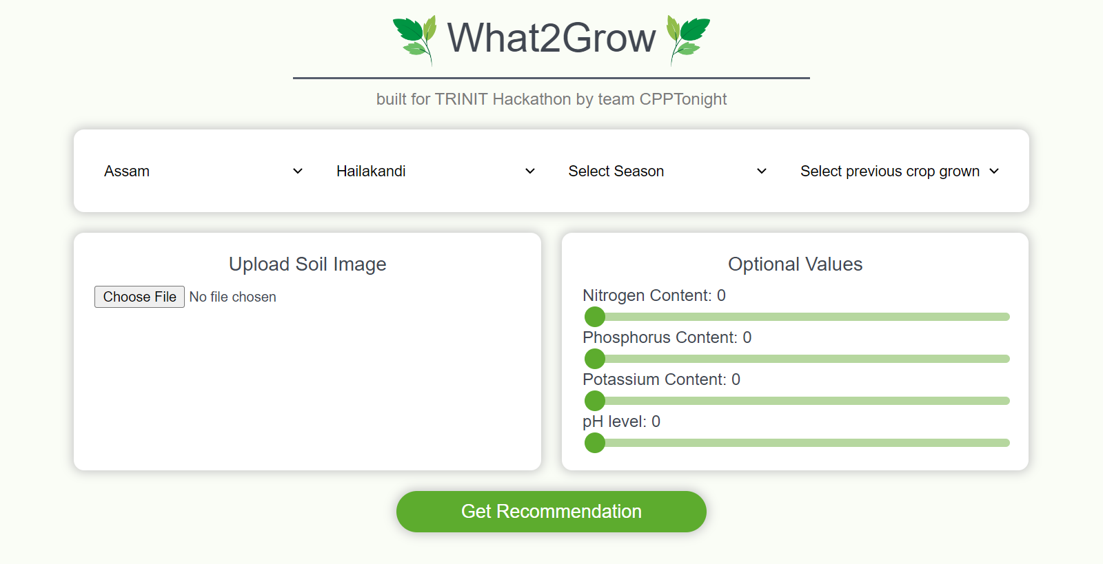
The website front-end

Slide 24
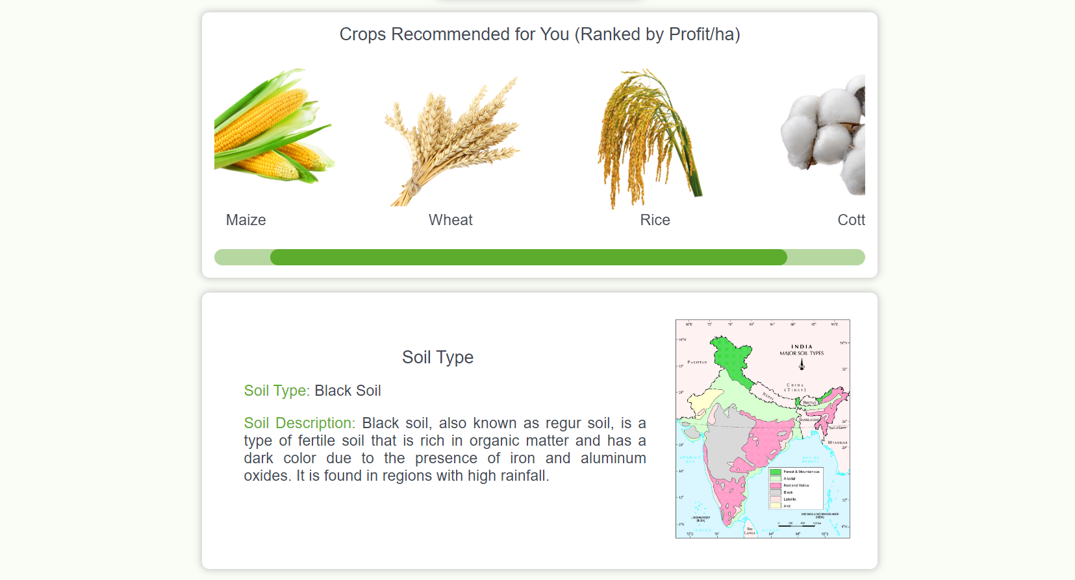
Sample Output

Slide 25
Conclusion

Slide 26

We have met all four briefs with our system!
1
2
Predict what crop would be best for the farmer to
grow based on the geolocation, season, and price.
Build a user-friendly interface for the public to interact with your ML model.
Suggest a variety of crops that could be cultivated for the geo-locations provided in the dataset and rank them according to the sales price.
3
4
Factoring in the various types of soil found in various parts of India and its general nutritional composition.

Slide 27
Benefits
The model will help farmers to decide which crops to grow next.
Helps inexperienced farmers get into farming.
Will help them to generate maximum profit.
Will prevent soil from becoming nutrient deficit by suggesting alternate crops.
Easily Scalable, can add more crops and districts.
High accuracy ML models and easy to use website with graphics.

Slide 28





Future Work
1
2
3
4
Adding more crops and crop sub varieties
Converting state wise data to district wise data
Taking into account fertilizers, adjacent that affect NPK
Support for local languages for more accessibility

Slide 29
Thank You!

